Slide 1


TE Project Based Seminar
on
Study of Different Deep Learning Models used in Stock Price Prediction
Students name Harshali Bedmutha
Roll No 306006
Guides name Dr. Mrs. Himangi Pande

Slide 2
AGENDA
To Study Different Deep Learning Algorithms
to Predict Stock Price

Slide 3
Introduction
A stock market, equity market or share market is the aggregation of buyers and sellers of stocks (also called shares), which represent ownership claims on businesses; these may include securities listed on a public stock exchange as well as those only traded privately.
Stock market prediction is the act of trying to determine the future value of a company stock or other financial instrument traded on an exchange.
The successful prediction of a stock's future price could yield significant profit.

Slide 4
Introduction to Deep Learning
D

Slide 5
Literature Review
Sr. no | Title | Description | Results
1 | Sreelekshmy Selvin, Vinayakumar R, Gopalakrishnan E.A, Vijay Krishna Menon, ‘STOCK PRICE PREDICTION USING LSTM,RNN AND CNN-SLIDING WINDOW MODEL’, International Conference on Advances in Computing, Communications and Informatics (ICACCI),IEEE, Udupi, India, Sept 2017 | Time series analysis of stock data using LSTM, RNN and CNN for two different sectors(IT and Pharma sector) Use of a Sliding Window Approach Prediction made for next 10 minutes Comparison between the methods used (RNN,CNN LSTM) | CNN is proved to be the best in proposed method. CNN uses information given at particular instance for prediction and hence it outperforms the other algorithms.
2 | David M. Q. Nelson, Adriano C. M. Pereira, Renato A. de Oliveira, ‘Stock Market’s Price Movement Prediction With LSTM Neural Networks’, International Joint Conference on Neural Networks (IJCNN),IEEE, Anchorage, AK, USA,May 2017 | Long Short Term Memory (LSTM) is used to build a prediction system that predicts a particular stock will go up in next 15 minutes or not. Kruskal-Wallis algorithm is used for testing | The model has a p value less than 0.05 The model outperforms random forest model

Slide 6
Sr. no | Title | Technique | Results
3 | Kai Chen ,Yi Jhou, Fangyan Dai , ‘A LSTM-based method for stock returns prediction : A case study of China stock market’ , IEEE International Conference on Big Data (Big Data), IEEE , Santa Clara, CA, USA, Nov 2015 | A single input layer, multiple LSTM layers , a dense layer and Single output layer is used. | Accuracy increased form 14.3% of existing systems to 27.2% of the proposed method. Results revealed that normalization was very useful for improving accuracy
4 | M. Ugur Gudelek ,S. Arda Boluk, A. Murat Ozbayoglu ,’A Deep Learning based Stock Trading Model with 2-D CNN Trend Detection’ , IEEE Symposium Series on Computational Intelligence (SSCI), IEEE, Honolulu, HI, USA ,Nov 2017 | Uses Exchange Traded Fund(ETF) as a factor to eliminate volatility and hence increase accuracy A virtual paper trading system is simulated where we buy and sell stocks to demonstrate that the method outperforms | Accuracy 70% High precision, recall and accuracy and significantly outperforms Buy and Hold strategy.

Slide 7
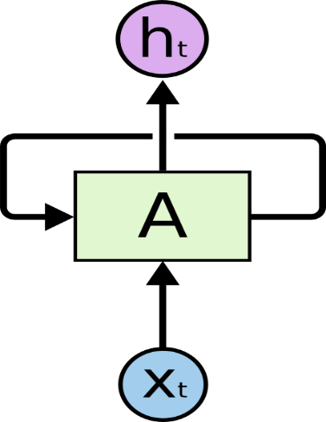
Recurrent Neural Network(RNN)
Humans! Our memory have persistence.
What about the traditional neural networks? They don’t !
For example, imagine you want to classify what kind of event is happening at every point in a movie. It’s unclear how a traditional neural network could use its reasoning about previous events in the film to inform later ones.
Recurrent neural networks address this issue. They are networks with loops in them, allowing information to persist.
Recurrent Neural Networks have loops.

Slide 8
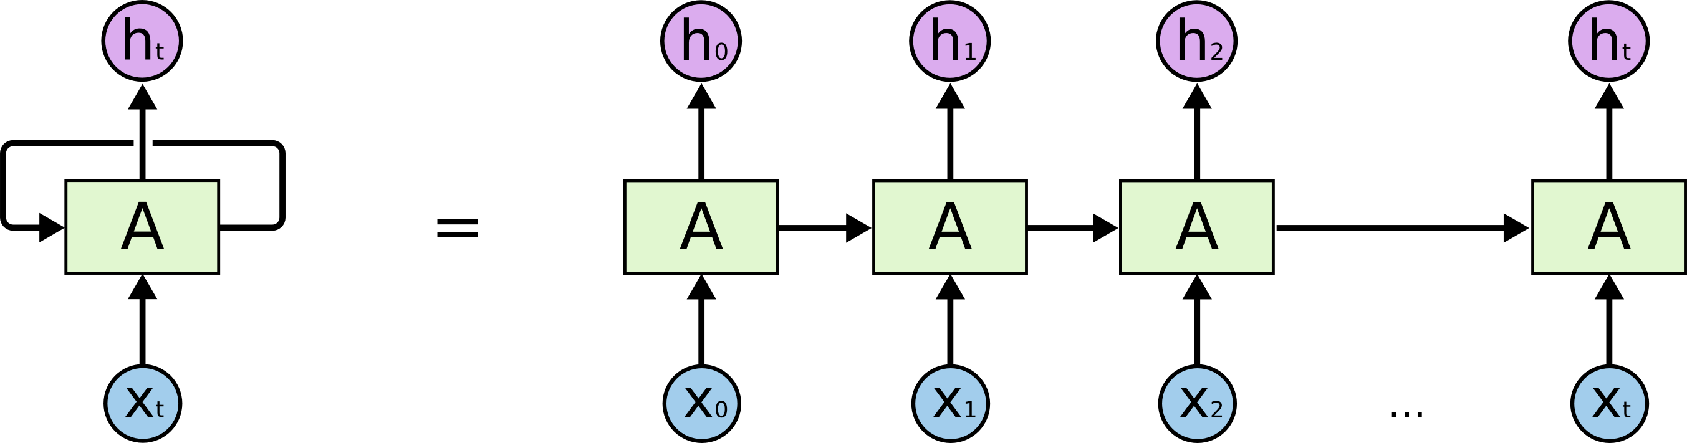
What happens if we unroll the loop ?
Drawback Long term dependency issue(Elaborate with example)[3]

Slide 9
LSTM-Long Short Term Memory
capable of learning long-term dependencies.
LSTMs are explicitly designed to avoid the long-term dependency problem. Remembering information for long periods of time is practically their default behaviour, not something they struggle to learn!
The LSTM does have the ability to remove or add information to the cell state, carefully regulated by structures called gates.
Gates are a way to optionally let information through

Slide 10

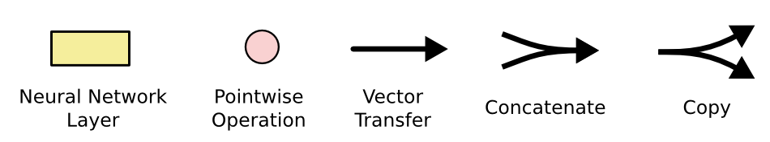

Slide 11
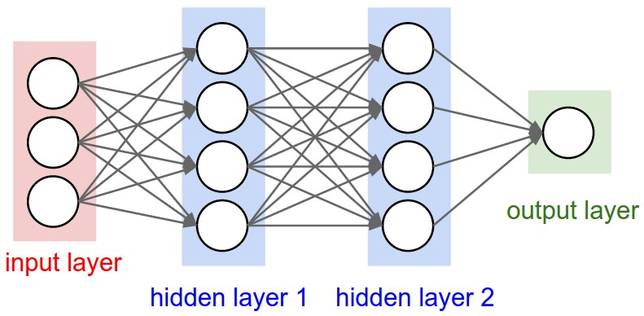
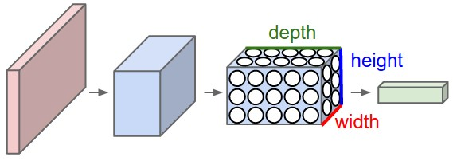
Convolutional Neural Networks(CNN)
CNN architectures make the explicit assumption that the inputs are images, which allows us to encode certain properties into the architecture.
These then make the forward function more efficient to implement and vastly reduce the amount of parameters in the network.
RNN
CNN

Slide 12
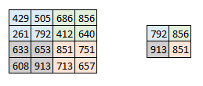
How CNN work?
Step 1: The convolution Layer
Step 2: Pooling Layer
Step 3: The output layer

Slide 13
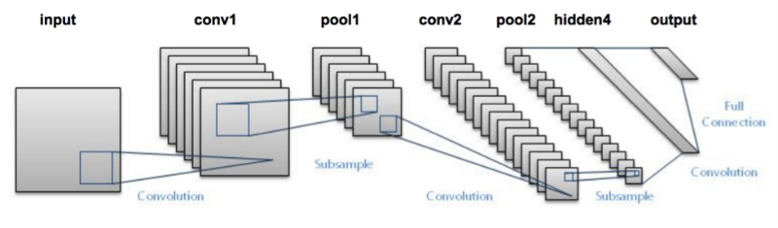
Putting it all together -

Slide 14
A time series analysis of stock data
Methodology
The data set consists of minute wise stock price for 1721 NSE listed companies for the period of July 2014 to June 2015.
It includes informations like day stamp, time stamp, transaction id, stock price and volume of stock sold in each minute.
Two different sectors, IT sector and Pharma sector.
The data for these three companies were extracted from the available data and was subjected to preprocessing to obtain the stock price.
The work is based on a sliding window approach for a short term future prediction.
The window size was ﬁxed to be 100 minutes with an overlap of 90 minute’s information and prediction was made for 10 minutes in future.

Slide 15
A time series analysis of stock data
DATA
MODEL
PROCESSING
ERROR
CALCULATION

Slide 16
We have used three different deep learning architectures, RNN, LSTM and CNN for this work.
RNN is a class of neural network where connections between the computational units form a directed circle. Unlike feed forward networks, RNN can use their internal memory to process arbitrary sequence of inputs. Each of the computing unit in an RNN has a time varying real valued activation and modiﬁable weight. RNNs are created by applying the same set of weights recursively over a graph-like structure
ht = f(ht−1,xt;θ) In the case of RNN, the learned model always has the same input size, because it is speciﬁed in terms of transition from one state to another. Also the architecture uses the same transition function with the same parameters at every time step.

Slide 17
LSTM is a special kind of RNN. The cells are composed of various gates that can control the input ﬂow.
An LSTM cell consists of input gate, cell state, forget gate, and output gate. It also consists of sigmoid layer, tanh layer and point wise multiplication operation.
The cell state is updated based on the outputs form the gates.

Slide 18
Mathematically
ft = σ(Wf.[ht−1,xt] + bf)
it = σ(Wi.[ht−1,xt] + bi)
ct = tanh(Wc.[ht−1,xt] + bc)
ot = σ(Wo[ht−1,xt] + bo)
ht = ot ∗tanh(ct)
Where,
xt: input vector ht: output vector ct: cell state vector
ft: forget gate vector it: input gate vector ot: output gate vector
and W, b are the parameter matrix and vector

Slide 19
CNN architectures mainly focuses on the given input sequence and does not use any previous history or information during the learning process.
The motivation behind testing the models with data from other companies is to check for interdependencies among the companies and to understand the market dynamics.
The error percentage was calculated using
ep = abs[ Xi(real) −Xi(predicted) ] * 100
Xi(real)

Slide 20
RESULTS
From the table it is clear that CNN is giving more accurate results than the other two models.
This is due to the reason that CNN does not depend on any previous information for prediction. It uses only the current window for prediction.
TABLE : ERROR PERCENTAGE
Company | RNN | LSTM | CNN
Infosys | 3.90 | 4.18 | 2.36
TCS | 7.65 | 7.82 | 8.96
Cipla | 3.83 | 3.94 | 3.63

Slide 21
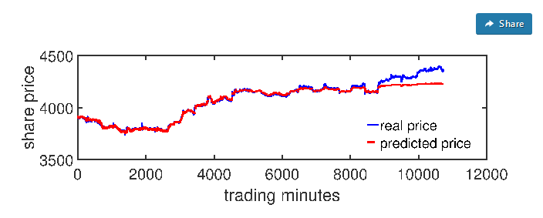
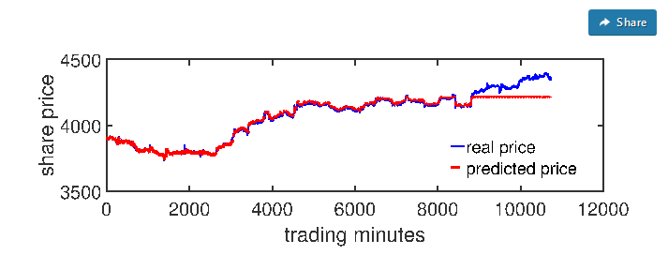
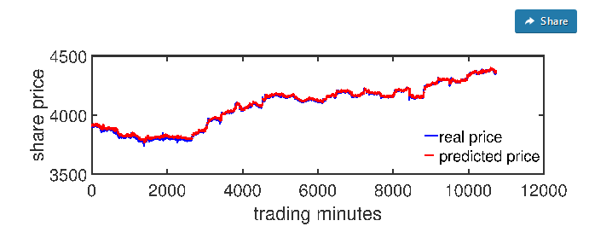
Fig. 1: Plot for Real value vs Predicted value for INFOSYS using LSTM
Fig. 1: Plot for Real value vs Predicted value for INFOSYS using RNN
Fig. 1: Plot for Real value vs Predicted value for INFOSYS using CNN

Slide 22
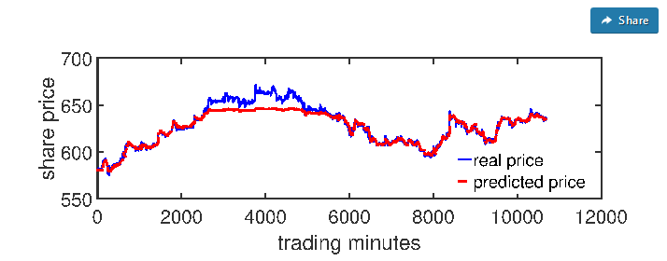
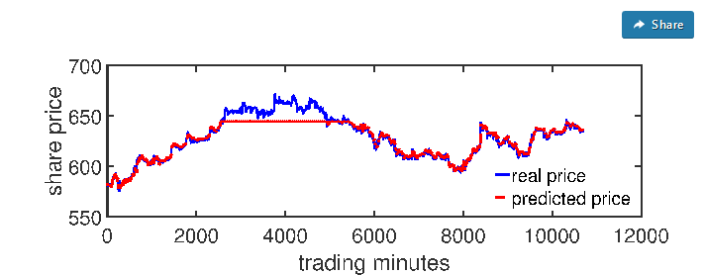
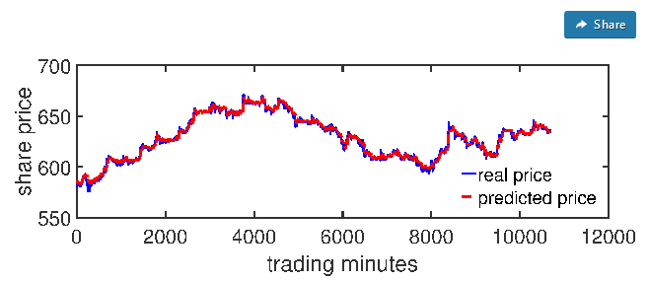
Fig. 1: Plot for Real value vs Predicted value for CIPLA using RNN
Fig. 1: Plot for Real value vs Predicted value for CIPLA using LSTM
Fig. 1: Plot for Real value vs Predicted value for CIPLA using CNN

Slide 23
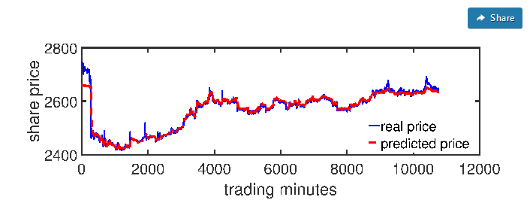
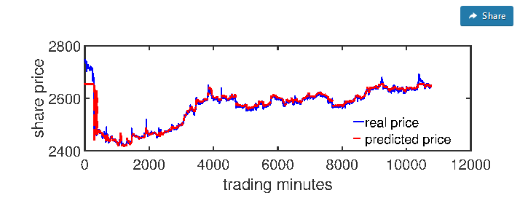
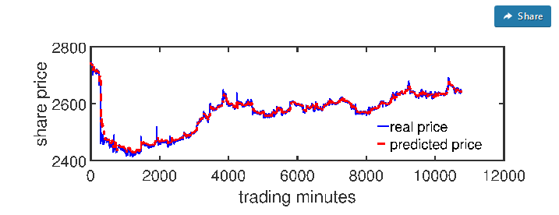
Fig. 1: Plot for Real value vs Predicted value for TCS using RNN
Fig. 1: Plot for Real value vs Predicted value for TCS using LSTM
Fig. 1: Plot for Real value vs Predicted value for TCS using CNN

Slide 24
CONCLUSION
For proposed methodology CNN is the most efficient algorithm for time series analysis of stock data
Even though the other two models are used in many other time dependent data analysis, it is not out performing the CNN architecture in this case.
This is due to sudden changes in stock market that CNN outperforms the rest of the algorithms

Slide 25
Future work
Including semantic analysis along with time series analysis to improve accuracy of prediction
Inclusion of techniques like gamification to make the system more user friendly

Slide 26
References
[1] Sreelekshmy Selvin, Vinayakumar R, Gopalakrishnan E.A, Vijay Krishna Menon, ‘STOCK PRICE PREDICTION USING LSTM,RNN AND CNN-SLIDING WINDOW MODEL’, International Conference on Advances in Computing, Communications and Informatics (ICACCI),IEEE, Udupi, India, Sept 2017
[2] Kai Chen ,Yi Jhou, Fangyan Dai , ‘A LSTM-based method for stock returns prediction : A case study of China stock market’ , IEEE International Conference on Big Data (Big Data), IEEE , Santa Clara, CA, USA, Nov 2015
[3] David M. Q. Nelson, Adriano C. M. Pereira, Renato A. de Oliveira, ‘Stock Market’s Price Movement Prediction With LSTM Neural Networks’, International Joint Conference on Neural Networks (IJCNN),IEEE, Anchorage, AK, USA,May 2017
[4] M. Ugur Gudelek ,S. Arda Boluk, A. Murat Ozbayoglu ,’A Deep Learning based Stock Trading Model with 2-D CNN Trend Detection’ , IEEE Symposium Series on Computational Intelligence (SSCI), IEEE, Honolulu, HI, USA ,Nov 2017

Slide 27
References
[5] colah.github.io/posts/2015-08-Understanding-LSTMs/
[6]https://www.semanticscholar.org/paper/Stock-price-prediction-using-LSTM%2C-RNN-and-window-Selvin-Vinayakumar/64ca5f3e4fa2d33ae860bebaea81420fae0759af
[7]https://en.wikipedia.org/wiki/Stock_market
[8] http://faganasset.com/2015/04/16/if-not-the-stock-market-then-where/
[9] cs231n.github.io/convolutional-networks/
[10] deeplearning4j.org

